Slide 1
5-1 USING IT TO TALK ABOUT TIME
What day is it?
Sunday
Monday
Tuesday
Wednesday
Thursday
Friday
Saturday

Slide 2
5-1 USING IT TO TALK ABOUT TIME
QUESTION
ANSWER
(a) What day is it?
(b) What month is it?
(c) What year is it?
(d) What’s the date today?
It’s Friday.
It’s January.
It’s 2011.
It’s January 13th.
It’s the 13th of January

Slide 3
5-1 USING IT TO TALK ABOUT TIME
QUESTION
ANSWER
(e) What time is it?
It’s 5:00.
It’s five.
It’s five o’clock.
It’s five (o’clock) P.M.

Slide 4
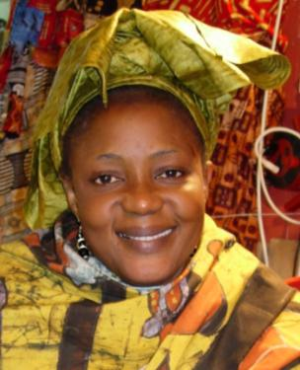
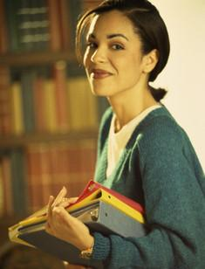
5-1 Let’s Practice
What day is it?
______________.
It’s
Sunday
Sunday
Monday
Tuesday
Wednesday
Thursday
Friday
Saturday

Slide 5
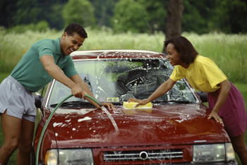
5-1 Let’s Practice
What day
is it
_______________?
It’s November 29th.
November
Sun | Mon | Tue | Wed | Thu | Fri | Sat
 |  | 1 | 2 | 3 | 4 | 5
6 | 7 | 8 | 9 | 10 | 11 | 12
13 | 14 | 15 | 16 | 17 | 18 | 19
20 | 21 | 22 | 23 | 24 | 25 | 26
27 | 28 | 29 | 30

Slide 6

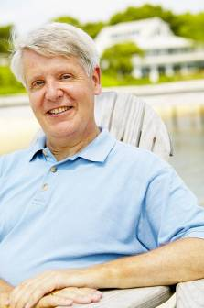
5-1 Let’s Practice
What time
is it
_______________?
1:30

Slide 7
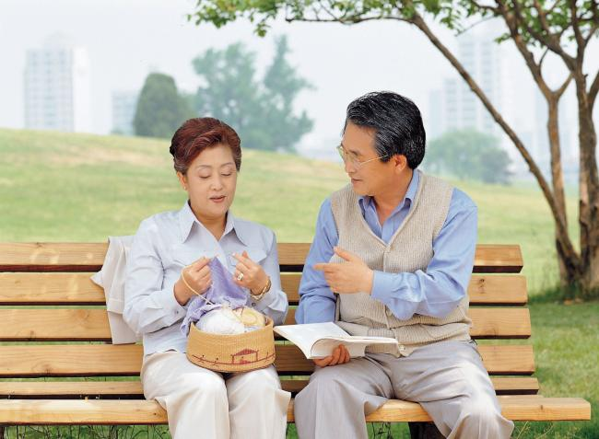
5-1 Let’s Practice
What’s the date today
___________________?
It´s May 3rd, 2012.
May 2012
Sun | Mon | Tue | Wed | Thu | Fri | Sat
 |  |  |  | 1 | 2 | 3
4 | 5 | 6 | 7 | 8 | 9 | 10
11 | 12 | 13 | 14 | 15 | 16 | 17
18 | 19 | 20 | 21 | 22 | 23 | 24
25 | 26 | 27 | 28 | 29 | 30 | 31

Slide 8
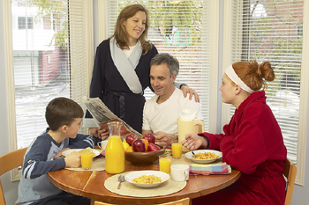
5-2 PREPOSITIONS OF TIME
We eat breakfast
in the morning.

Slide 9
5-2 PREPOSITIONS OF TIME
at
(a) We get up at 5:00 A.M.
(b) We exercise at 2:00 P.M.
at + specific time

Slide 10
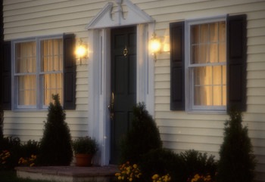
5-2 PREPOSITIONS OF TIME
at
(c) I get home at night.
at + night

Slide 11
5-2 PREPOSITIONS OF TIME
in
(d) School starts in September.
(e) She went to Florida in 2005.
(f) I take a walk in the morning.
in + the morning
in + month
in + year

Slide 12
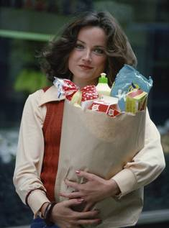
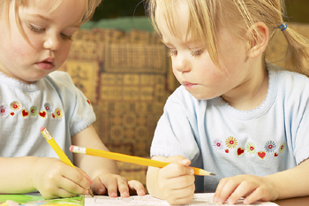
5-2 PREPOSITIONS OF TIME
on
(i) She goes shopping on Tuesday.
(j) The twins were born on
March 3, 2005.
on + specific date
on + specific day

Slide 13
5-2 PREPOSITIONS OF TIME
From ... to
(k) I work from 9:00 to 5:00.
from (a time) to (a time)

Slide 14
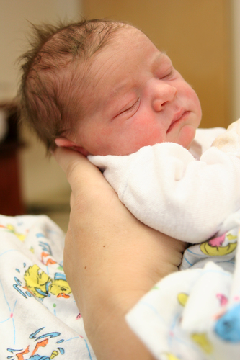
5-2 Let’s Practice
at in on from ... to
on
The baby was born __ Monday.
The baby was born __ July.
in
at
The baby was born __ 2:00 A.M.

Slide 15
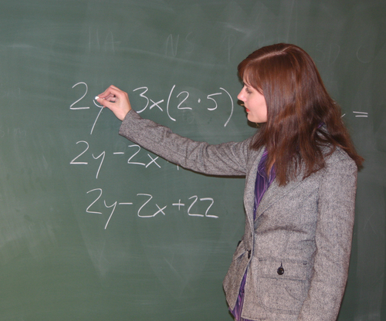
5-2 Let’s Practice
at in on from ... to
I teach a class __ 8:30 A.M. __ Monday.
at
on

Slide 16
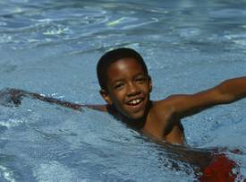
5-2 Let’s Practice
at in on from ... to
He swims __ the afternoon.
in

